Slide 1

Impact of screen time on adolescents and adults (8-17 years, 18+ years)
Group 3 - Jaime Bunay, Payal Surana, Sadhvi Grover

Slide 2
AGENDA
Hypothesis
Data Visualization & Analysis
Conclusion

Slide 3


Slide 4
📱 Impact of Screen Time on Daily Life
High Daily Usage:
Adolescents (8–17): Up to 9 hours/day , Adults (18+): Up to 13 hours/day
Benefits of Screen Use:
Access to education, communication, and entertainment
Negative Effects of Prolonged Screen Time:
📉 Reduced cognitive function 😴 Disrupted sleep patterns 🎓 Decline in academic performance 🏃‍♂️ Poor physical health and activity levels

Slide 5
Methodology….
We followed a series of data preparation steps to ensure clean, consistent, and comparable data across both datasets before merging them:
1. Data Cleaning & Imputation
Replaced missing values using mode (categorical) and median (numerical)
Ensured consistent formatting across all variables
2. Unit Conversion & Binning
Converted screen time & physical activity from seconds to minutes
Created Age Bins (8–11, 12–14, 15–17, 18–20, 21–22) for grouped analysis
3. Grade Standardization
Mapped scores to letter grades (A–F) using a college-style scale → Below 60% = F

Slide 6

AND ANALYSIS

Slide 7
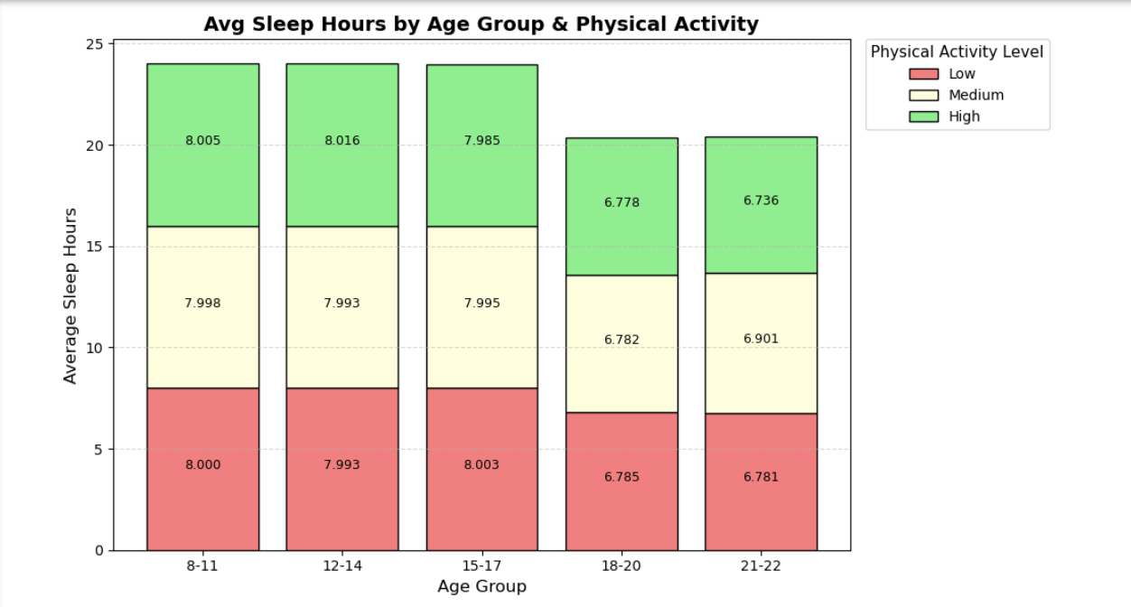
Average Sleep Hours by Age Group & Physical Activity
Screen time is a growing part of both work and leisure, especially for adolescents and adults.
Increased screen exposure is often linked to poor sleep quality and lower physical activity.
Adolescents (8–17) average ~8 hours of sleep across all activity levels.
Adults (18+) sleep less — even highly active adults average only 6–7 hours.

Slide 8
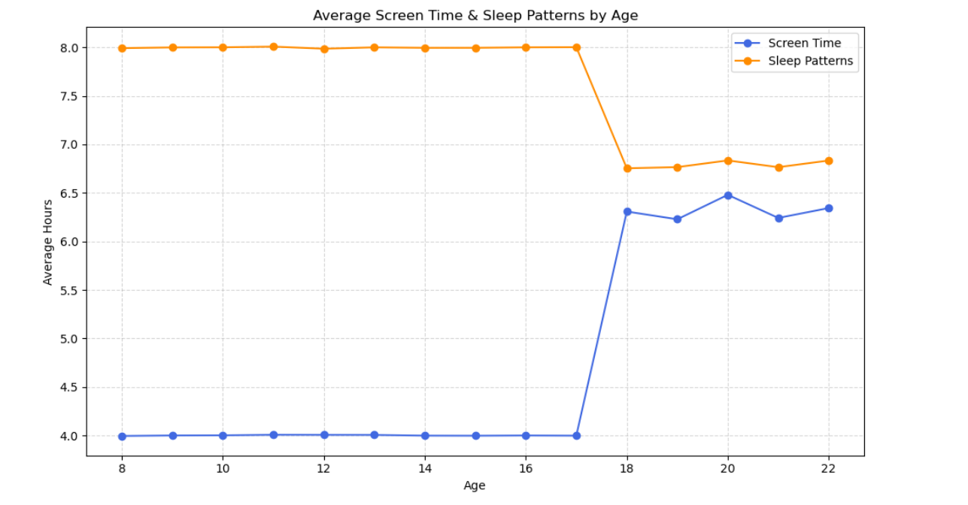
Average Screen Time & Sleep Patterns by Age
As individuals transition from adolescence (8–17) to adulthood (18+), screen time rises from ~4 to 6+ hours, while average sleep drops from ~8 to under 7 hours.
This trend suggests that increased screen exposure may be contributing to reduced sleep duration and quality in early adulthood.

Slide 9
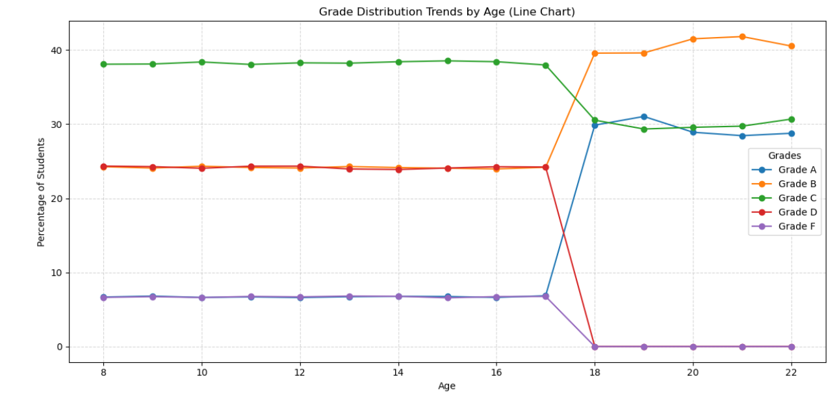
Grade Distribution Trends by Age
Grades remain stable from ages 8–17, with most students receiving Cs and Ds. At age 18, there’s a clear shift: Grades A and B increase, while lower grades decline.
This may reflect higher academic focus or grading system changes in adulthood.
Despite less sleep and more screen time, adult academic performance improves.
Are better grades coming at the cost of well-being?

Slide 10
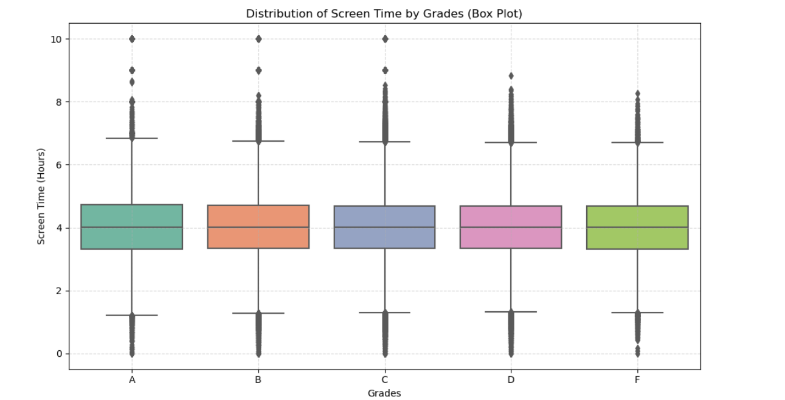
Distribution of Screen Time by Grades
Average screen time is similar across all grades (~4 hours/day).
Students with high grades (A/B) spend as much time on screens as those with lower grades.
Suggests that how screen time is used (e.g., studying vs. entertainment) matters more than duration.
Other factors like sleep, focus, and time management may play a bigger role in academic outcomes.

Slide 11
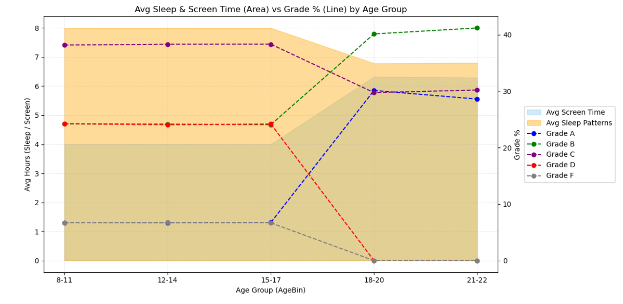
Average Sleep & Screen Time vs Grade % by Age Group
Ages 8–17: More sleep, less screen time, and a balanced grade distribution.
Age 18+: Sharp increase in screen time, drop in sleep, and rise in A/B grades.
Suggests a trade-off: better grades may come at the cost of rest and well-being.
Raises the question: Is academic success sustainable if it impacts health and balance?

Slide 12
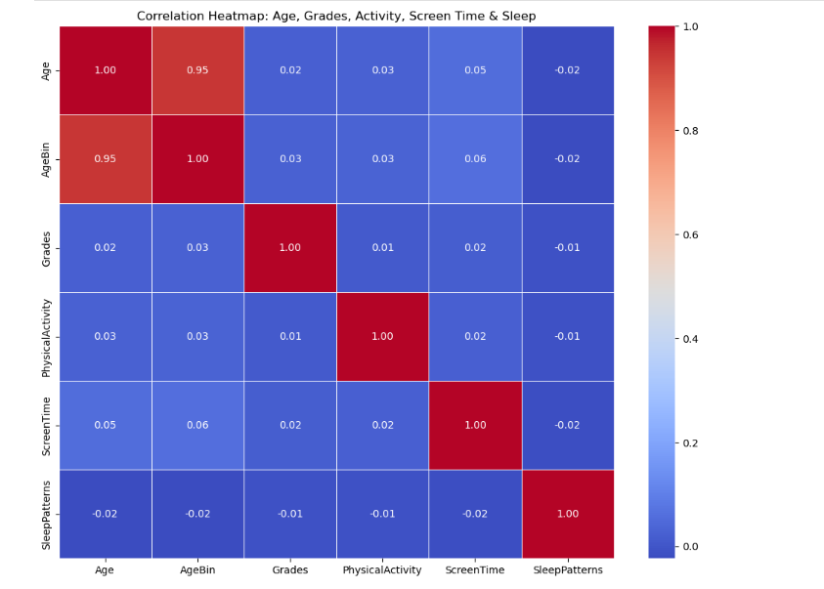
Avge Sleep & Screen Time vs Grade % by Age Group
Despite clear visual trends, correlations between variables are weak.
Screen time shows little to no direct impact on grades or sleep.
Age is not strongly linked to academic performance or lifestyle habits.
Suggests that screen time’s impact depends on context - - how it’s used and other factors (e.g., stress, motivation).

Slide 13
Hypothesis Conclusion:
Hypothesis is partially supported by the data.
Screen time increases and sleep declines after age 18.
Academic performance improves, but may come at the cost of sleep and balance.
Not just the amount, but the purpose of screen time (productive vs. passive) matters.
Weak correlations suggest outcomes are shaped by broader lifestyle factors.
Emphasizes the need for deeper, context-aware research on digital habits.

Slide 14


Slide 15

THANK YOU

